Slide 1
Principles of Operations Management (LGT2106/LGT2B02)
Lecture 3
Capacity Management and Aggregate Planning

Slide 2
Lecture outline
Capacity management
Capacity and demand management in service
Capacity planning
Best operating level, economies of scale and diseconomies of scale
Capacity flexibility
Strategies for adding capacity
Steps for determining capacity requirements
Tactics for matching capacity to demand
Managing demand
Aggregate planning
Production planning strategies
Aggregate production plans
Aggregate planning and master production schedule

Slide 3
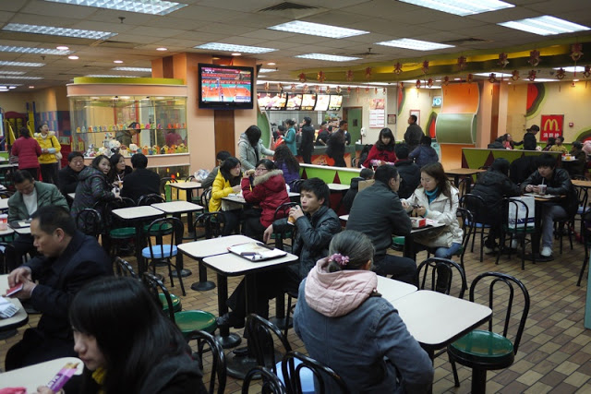

Capacity
Capacity is the ability to hold, receive, store or accommodate

Slide 4
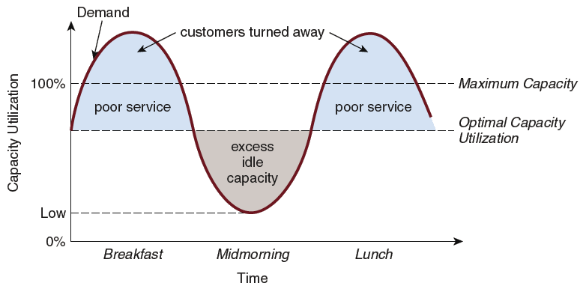
Comparing capacity and demand for a food service facility
Notes:
Optimal=70%

Slide 5
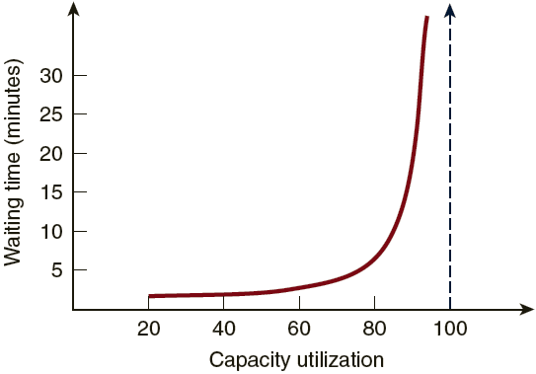

Slide 6
Balancing capacity and demand
Demand exceeds capacity
Customers are turned away
E.g., you receive a busy signal when you call to make a hotel reservation
Demand exceeds optimum capacity
Customers receive poor service
E.g., you have to wait more than an hour to be seated in a very busy restaurant
Demand equals optimum capacity
Customers are service properly
E.g., your wait at the supermarket checkout is short even though all of the checkout stations are being used
Demand is less than optimum capacity
There is idle capacity
E.g., your telephone call is answered immediately or you are seated immediately in a restaurant
Too much capacity—costs rise
Too little capacity—customers are lost

Slide 7



Capacity and demand management in the service sector
Capacity management
Full time, temporary, part-time staff
Demand management
Appointments, reservations, FCFS rule

Slide 8
Capacity planning
Long-range planning
Focuses on strategic issues relation to capacity, process, selection, and plant location
HKIA: https://youtu.be/ipM2zBo8_zI?t=4m20s
Intermediate-range planning
Focuses on tactical issues pertaining to aggregate workforce and material requirements for the coming year
Short-range planning
Addresses day-to-day issues of scheduling workers on jobs at assigned work stations

Slide 9
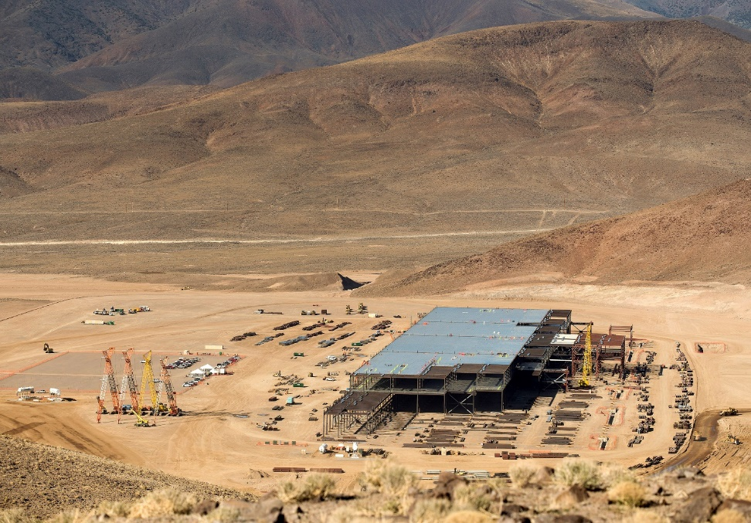
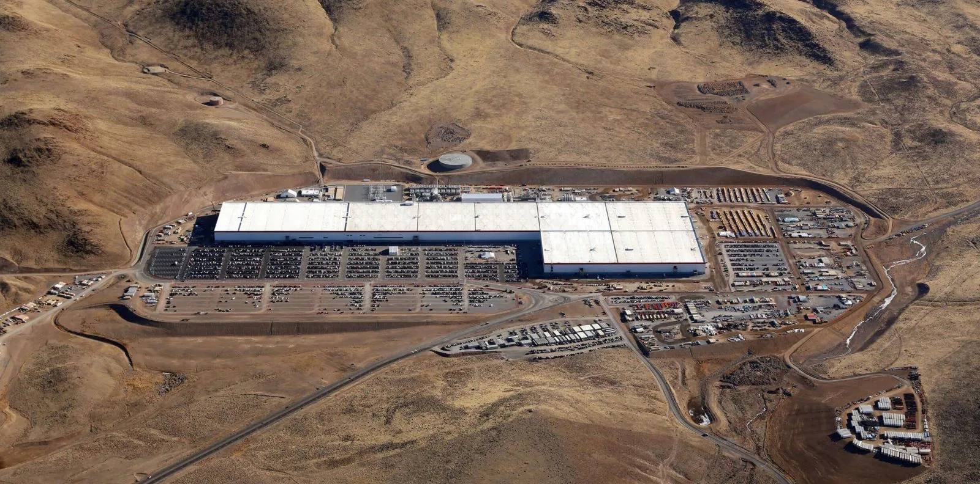
Long-range planning
Tesla Gigafactory

Slide 10
Factors affecting capacity decisions
External factors
Union agreements
Supplier capabilities
Government regulations
Internal factors
Product and service design
Plant layout and process flow
Personnel and jobs
Management capabilities
Equipment capabilities and maintenance
Materials management
Quality control systems

Slide 11
Production system capacity affects
Composition of the workforce
Extent of management and staff support
Level of production technology utilized
General inventory strategy
Response rate to market changes
Overall product cost structure

Slide 12
Best operating level and (dis)economies of scale
Best operating level
The capacity (production volume) for which the average unit cost of output is at a minimum
Economies of scale
The output range in which average unit costs decrease as unit production volumes increase
Lower operating and capital costs
Per unit cost of equipment drops
More specialization of labor
Diseconomies of scale
The output range in which average unit costs rise due to added costs incurred at operating levels exceeding the best operating level

Slide 13
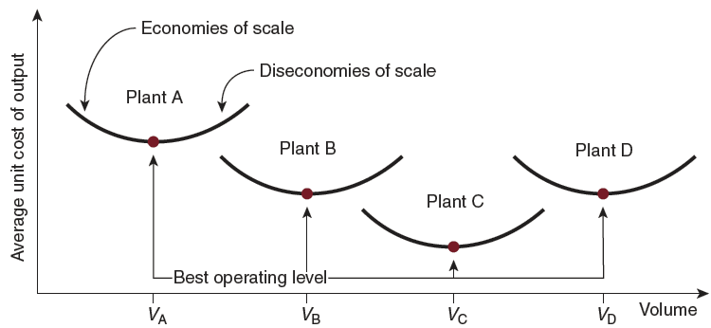
Economies and diseconomies of scale

Slide 14
Economies and diseconomies of scale example
UK hospital size
Economies of scale (<200 beds)
Optimal (between 200 and 400 beds)
Diseconomies of scale (>400 beds)
Source: Posnett, S. (1999), The hospital of the future: Is bigger better? Concentration in the provision of secondary care, British Medical Journal, 319, 7216, pp. 1063-65.

Slide 15
Capacity flexibility
The ability to rapidly increase or decrease production levels or to shift production capacity quickly from one product or service to another
Flexible plants: low changeover times
Flexible processes: easily set up equipment (https://www.osi-electronics.uk/)
Flexible workers: workers have multiple skills
External sources of capacity
Outsourcing
Sharing capacity

Slide 16
Strategies for adding capacity
Proactive
Anticipating future growth and building a facility so that it is up and running when the demand is there
Neutral
Additional capacity becomes available when demand is about 50 percent of planned added capacity
The issue is how best to satisfy demand before the plant is up and operating
Reactive
Plant capacity is not added until all of the planned output from the facility can be sold

Slide 17
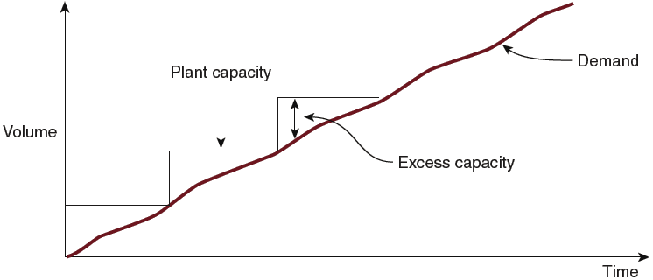
Proactive strategy

Slide 18
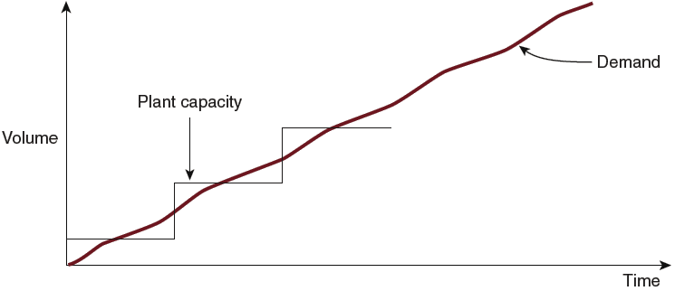
Neutral strategy

Slide 19
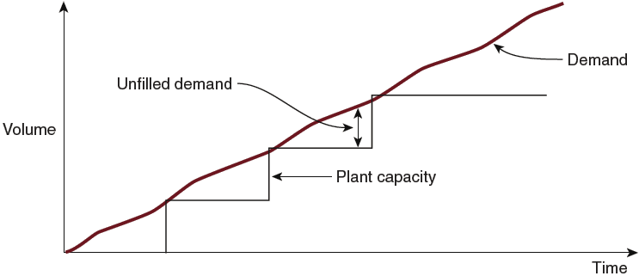
Reactive strategy

Slide 20
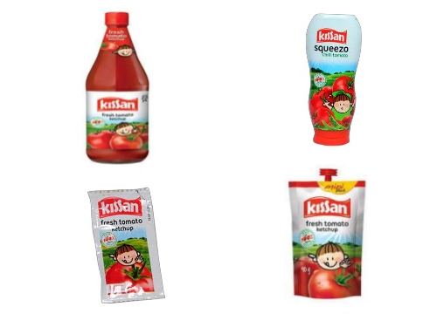
Steps for determining capacity requirements
Capacity planning
Determining which level of capacity to operate at to meet customer demand in a cost efficient manner
Forecast sales for each product line
Forecast sales for individual products within each line
Calculate labor and equipment requirements to meet product line forecasts
Project labor and equipment availabilities over the planning horizon

Slide 21
(recap) Capacity planning
Long-range planning
Focuses on strategic issues relation to capacity, process, selection, and plant location
HKIA: https://youtu.be/ipM2zBo8_zI?t=4m20s
Intermediate-range planning
Focuses on tactical issues pertaining to aggregate workforce and material requirements for the coming year
Short-range planning
Addresses day-to-day issues of scheduling workers on jobs at assigned work stations

Slide 22
Tactics for matching capacity to demand
Making staffing changes
Adjusting equipment
Purchasing additional machinery
Selling or leasing out existing equipment
Adding process flexibility to meet changing product preferences
Improving processes to increase throughput
Redesigning products to facilitate more throughput
Closing facilities

Slide 23
Managing demand
Demand exceeds capacity
Curtail demand by raising prices, scheduling longer lead time
Long term solution is to increase capacity
Capacity exceeds demand
Stimulate market
Product changes
Adjusting to seasonal demands
Produce products with complementary demand patterns

Slide 24

Complementary demand patterns
4,000 –
3,000 –
2,000 –
1,000 –
Sales in units
Jet ski engine sales
J F M A M J J A S O N D J F M A M J J A S O N D J
Time (months)

Slide 25

Complementary demand patterns
4,000 –
3,000 –
2,000 –
1,000 –
Snowmobile motor sales
Sales in units
J F M A M J J A S O N D J F M A M J J A S O N D J
Time (months)

Slide 26
Complementary demand patterns
Combining both demand patterns reduces the variation
4,000 –
3,000 –
2,000 –
1,000 –
Snowmobile motor sales
Sales in units
Jet ski engine sales
J F M A M J J A S O N D J F M A M J J A S O N D J
Time (months)

Slide 27
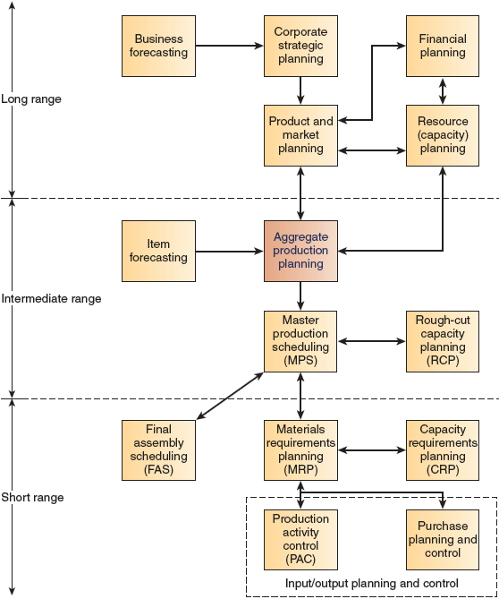
Overview of manufacturing planning activities
Aggregate Production Planning
The process for determining the most cost effective way to match supply and demand up to the next 18 months
Master Production Scheduling (MPS)
Short-term scheduling of specific end product requirements for the next several quarters
Rough-Cut/Resource Capacity Planning
Determining that adequate production capacity and warehousing are available to meet demand

Slide 28
Aggregate planning
Specify the optimal combination of
Production rate
The capacity of output per unit of time (such as units per day or units per week)
Workforce level
Number of workers required to provide a specified level of production
Inventory on hand
The surplus of units that results when production exceeds demand in a given time period
Backorder (or stockout)
The deficit in units that results when demand exceeds the number of units produced in a given time period

Slide 29
Required inputs

Slide 30
Production planning strategies
Chase strategy
Matching the production rate to exactly meet the order rate by hiring and laying off workers as the order rate varies
Stable workforce—variable work hours
Varying output by varying the number of hours worked through flexible schedules or overtime
Level strategy
Maintain a stable workforce working at constant output rate
Absorb demand variations with inventory, backlogs, or lost sales

Slide 31
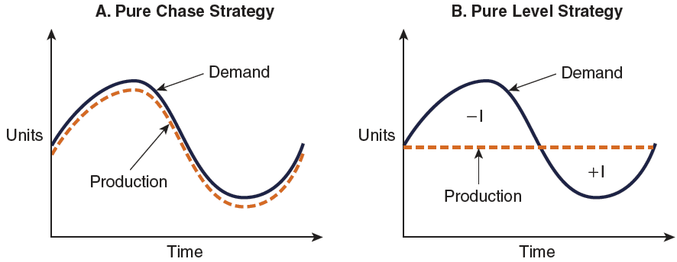
A pure chase/level strategy

Slide 32
Production planning strategies
Pure strategy
Either a chase strategy when product exactly matches demand or a level strategy when production remains constant over a specified number of periods
Mixed strategy
A combination of chase and level strategies to match supply and demand

Slide 33
Relevant costs
Basic production costs
The fixed and variable costs incurred in producing a given product type in a given time period
Costs associated with changes in the production rate
Hiring, training, and laying off personnel
Inventory holding costs
Capital, storing, insurance, taxes, spoilage and obsolescence
Backorder (stockout) costs
Loss of goodwill/sales
Full costs
All of the actual, out-of-pocket costs associated with a particular aggregate plan
Used for developing a labor and material budget

Slide 34
Forecasted Demand and Workdays for C&A Company
 | January | February | March | April | May | June | Totals
Demand Forecast (units) | 2250 | 1450 | 1100 | 900 | 1100 | 1600 | 8400
Number of Working Days by Month | 22 | 19 | 21 | 21 | 22 | 20 | 125
Costs
Materials cost | $100.00 | per unit
Inventory holding cost | $1.50 | per unit per month
Stockout cost | $5.00 | per unit per month
Subcontracting cost | $125.00 | per unit
Hiring and training cost | $200.00 | per worker
Layoff cost | $250.00 | per worker
Labor hours required per unit | 5.0 | per unit
Straight-time cost (first eight hours each day) | $4.00 | per hour
Overtime cost (time and a half) | $6.00 | per hour
Initial state
Initial inventory | 400 | units
Number of workers currently employed | 30

Slide 35
First Alternative: Pure Chase Strategy
January
February
March
April
May
June
Total
Demand forecast
2,250
1,450
1,100
900
1,100
1,600
8,400
Working days (per month)
22
19
21
21
22
20
125
Aggregate Plan
Beginning inventory
400
16
25
0
7
33
Production requirements
1,850
1,434
1,075
900
1,093
1,567
Workers Required
53
48
32
27
32
49
-
New Workers Hired
23
0
0
0
5
17
-
Workers Laid Off
0
5
16
5
0
0
Units produced
1,866
1,459
1,075
907
1,126
1,568
8,001
Ending inventory
16
25
0
7
33
1
Costs
Material cost
186,600
145,900
107,500
90,700
112,600
156,800
$800,100
Hiring cost
4,600
0
0
0
1,000
3,400
$9,000
Layoff cost
0
1,250
4,000
1,250
0
0
$6,500
Straight time cost
37,312
29,184
21,504
18,144
22,528
31,360
$160,032
Inventory carrying cost
24.0
37.5
0.0
10.5
49.5
1.5
$123
Total Cost
$975,755

Slide 36
Second Alternative: Pure Level Strategy
January
February
March
April
May
June
Total
Demand forecast
2,250
1,450
1,100
900
1,100
1,600
8,400
Working days (per month)
22
19
21
21
22
20
125
Initial inventory
400
Production requirements
1,850
1,450
1,100
900
1,100
1,600
8,000
Aggregate Plan
Workers Required
40
40
40
40
40
40
-
New Workers Hired
10
0
0
0
0
0
-
Workers Laid Off
0
0
0
0
0
0
Units produced
1,408
1,216
1,344
1,344
1,408
1,280
8,000
Monthly inventory
-
442
-
234
244
444
308
-
320
Cumulative inventory
-
442
-
676
-
432
12
320
0
Costs
Material costs
140,800
121,600
134,400
134,400
140,800
128,000
$800,000
Hiring cost
2,000
0
0
0
0
0
$2,000
Layoff cost
0
0
0
0
0
0
$0
Straight Time Cost
28,160
24,320
26,880
26,880
28,160
25,600
$160,000
Inventory carrying cost
0.0
0.0
0.0
18.0
480.0
0.0
$498
Stockout cost
2210.0
3380.0
2160.0
0.0
0.0
0.0
$7,750
Total Cost
$970,248

Slide 37
Third Alternative: Minimum Workforce with Subcontracting
Hire just enough workers to meet the minimum monthly demand
January
February
March
April
May
June
Total
Demand forecast
2,250
1,450
1,100
900
1,100
1,600
8,400
Working days (per month)
22
19
21
21
22
20
125
Aggregate Plan
Beginning inventory
400
0
0
0
7
0
Production requirements
1,850
1,450
1,100
900
1,093
1,600
Workers Required
27
27
27
27
27
27
-
New Workers Hired
0
0
0
0
0
0
-
Workers Laid Off
3
0
0
0
0
0
Units produced
950
821
907
907
950
864
5,399
Units subcontracted
900
629
193
0
143
736
2,601
Ending inventory
0
0
0
7
0
0
Costs
Material cost
95,000
82,100
90,700
90,700
95,000
86,400
$539,900
Hiring cost
0
0
0
0
0
0
$0
Layoff cost
750
0
0
0
0
0
$750
Straight time cost
19,008
16,416
18,144
18,144
19,008
17,280
$108,000
Inventory carrying cost
0.0
0.0
0.0
10.5
0.0
0.0
$10.5
Subcontracting Cost
112500.0
78625.0
24125.0
0.0
17875.0
92000.0
$325,125
Total Cost
$973,786

Slide 38
Fourth Alternative: Constant Workforce with Overtime and Inventory
Meet the demand for March-June using a constant work force on regular time
January
February
March
April
May
June
Total
Demand forecast
2,250
1,450
1,100
900
1,100
1,600
8,400
Working days (per month)
22
19
21
21
22
20
125
Initial inventory
400
Production requirements
1,850
1,450
1,100
900
1,100
1,600
8,000
Aggregate Plan
Workers Required
35
35
35
35
35
35
-
New Workers Hired
5
0
0
0
0
0
-
Workers Laid Off
0
0
0
0
0
0
Units produced
-
regular
1,232
1,064
1,176
1,176
1,232
1,120
7,000
Units produced
-
overtime
618
386
0
0
0
0
1,004
Monthly inventory
0
0
76
276
132
-
480
Cumulative inventory
0
0
76
352
484
4
Costs
Material costs
185,000
145,000
117,600
117,600
123,200
112,000
$800,400
Hiring cost
1,000
0
0
0
0
0
$1,000
Layoff cost
0
0
0
0
0
0
$0
Straight Time Cost
24,640
21,280
23,520
23,520
24,640
22,400
$140,000
Overtime Cost
18,540
11,580
0
0
0
0
$30,120
Inventory carrying cost
0.0
0.0
114.0
528.0
726.0
6.0
$1,374
Total Cost
$972,894

Slide 39
Summary of Costs for Aggregate Plans
Alternative | Full Costs
Pure Chase | $975,755
Pure Level | $970,248
Minimum workforce with subcontracting | $973,786
Constant workforce with overtime | $972,894

